Slide 1
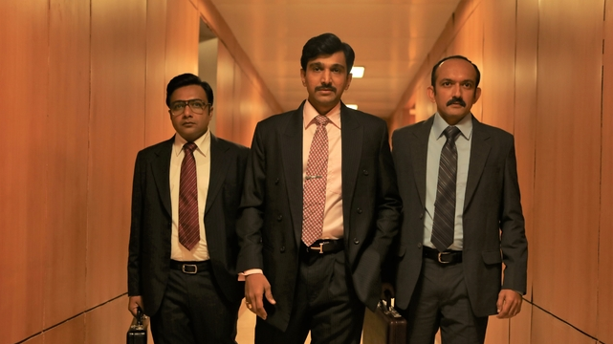

SCAMS IN INDIA
.

Slide 2
INTRODUCTION
Political and bureaucratical corruptions in India are major concerns.
In 2012 India was ranked 74th among 126 countries by of transparency international corruption index
According to the data provided by Swiss bank India has more black money then the rest of the world combined

Slide 3

WHAT IS SCAM
Obtaining money by means of deceptions including fake identity, fake photos and fake address, forged documents.

Slide 4
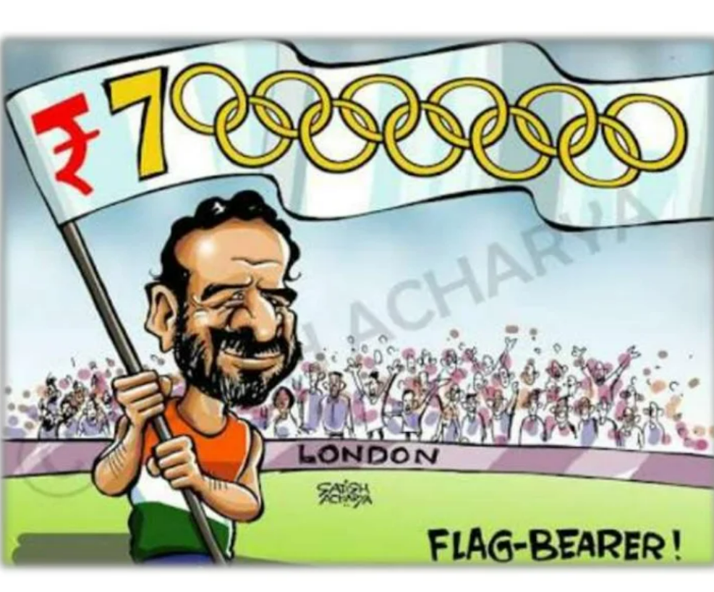
Commonwealth game scam

Slide 5

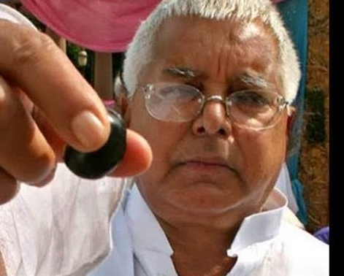
FODDER SCAM

Slide 6
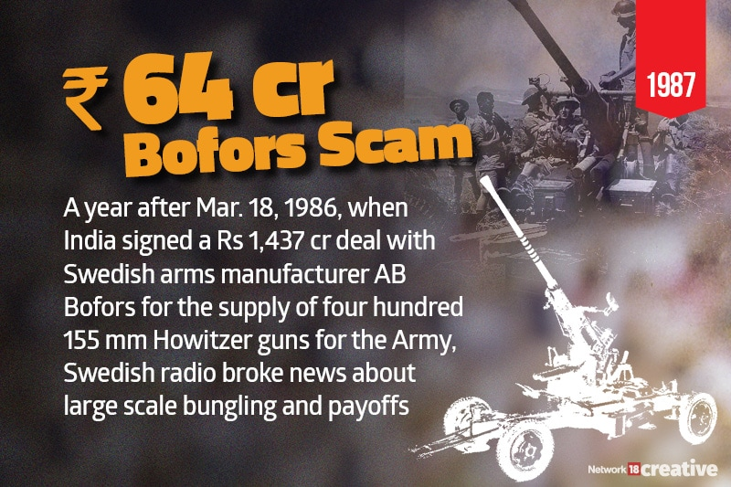
Bofors scam

Slide 7
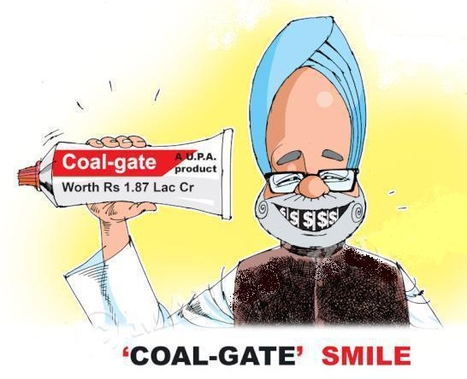
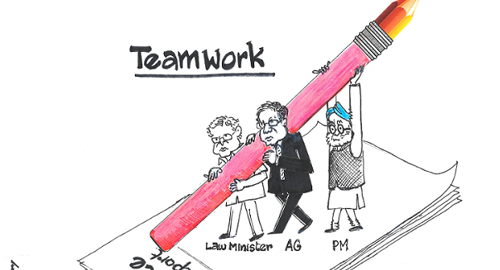
Coal-gate scam

Slide 8
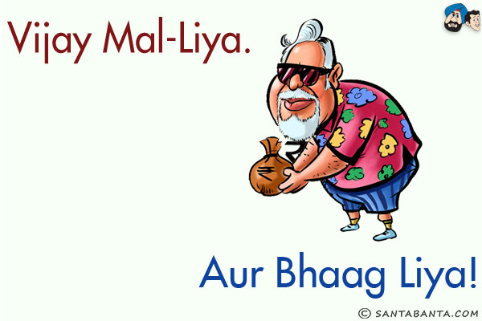
Vijay Mallya scam

Slide 9
